Slide 1
Agile vs. waterfall: A Comparative Overview for ChadaTech leadership
Insights from the SNHU travel project
Presented by: Josh Perry
Date: December 9th, 2023

Slide 2
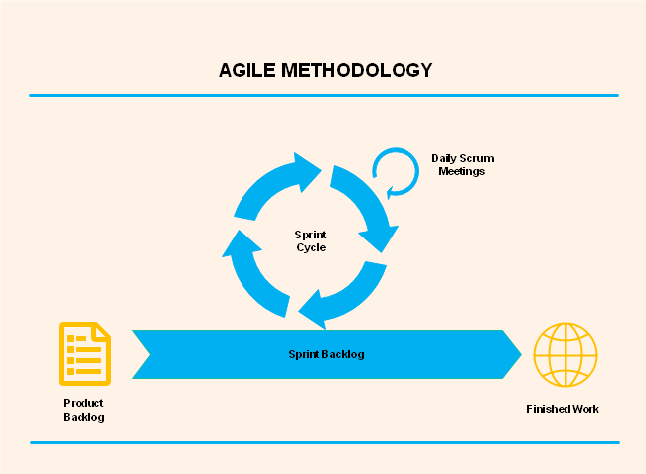
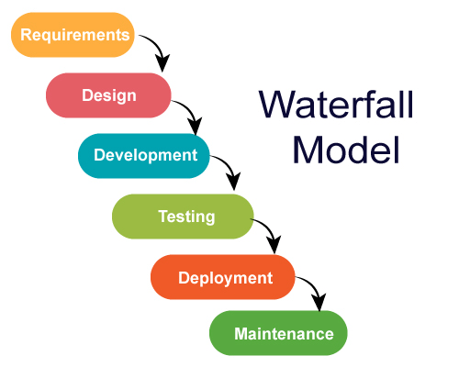
Introduction to agile and waterfall
agile
waterfall
Agile is characterized by its iterative, flexible nature, and adapts to changes and feedback throughout the development process.
Waterfall is a linear and sequential approach, where each phase must be completed before the next begins, making it less adaptable to changes.

Slide 3
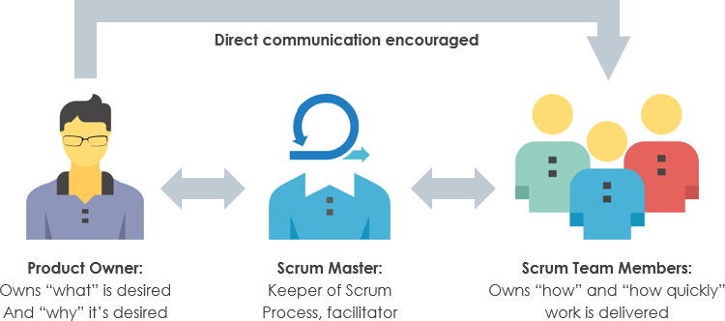
Roles in a scrum-agile team
Product owner
Scrum master
Development team
Acts as the liaison between the stakeholders and the development team. Responsible for defining the product vision, managing the product backlog, and ensuring that the team delivers value to the business.
Facilitates Scrum processes, ensures team efficiency, and removes any impediments that the team may face. Acts as a coach and protector for the team.
A group of cross-functional members (developers, designers, QA analysts) who collaboratively design, build, and test the product in increments.

Slide 4
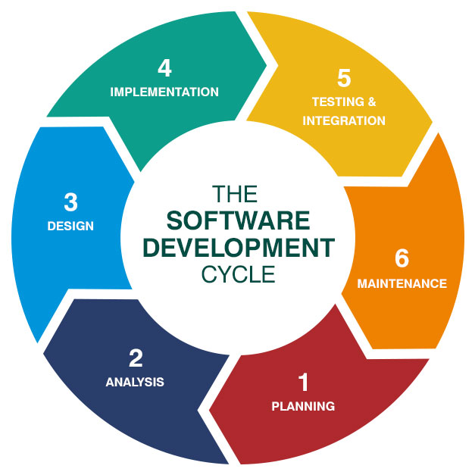
Agile sdlc phases
Concept and Inception
The stage where the project’s vision and scope are defined.
Iteration/Development
Involves iterative development cycles known as sprints, where the team works on a set of features from the product backlog.
Release
Involves delivering the product to the market, often in incremental releases.
Maintenance
Ongoing support, bug fixing, and updates to the product.
Retirement
The final phase where the product is retired from active support.

Slide 5
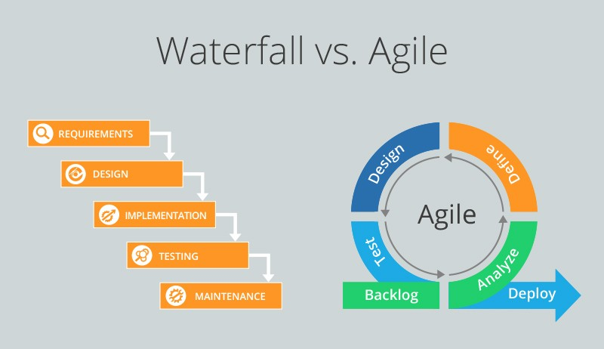
Agile vs. waterfall in process
In Agile, changes are welcomed and can be incorporated even in the later stages of development.
In Waterfall, changes are difficult and costly once the project has progressed beyond the initial stages.

Slide 6
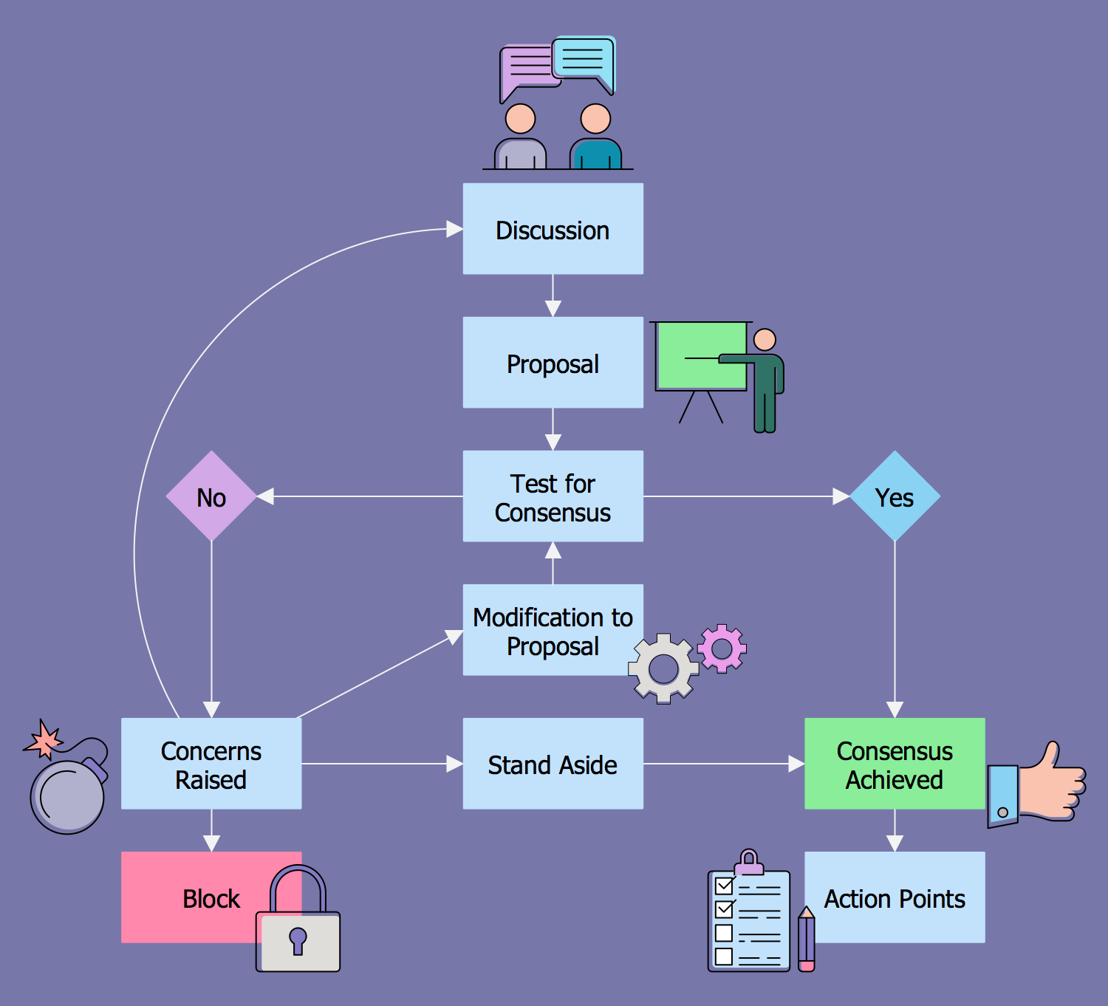
Factors in choosing agile or waterfall
Factors to consider include project size and complexity, client involvement, and risk management.
Agile is suitable for complex, evolving projects with high client involvement.
Waterfall is more suited for projects with well-defined requirements and low likelihood of change.

Slide 7
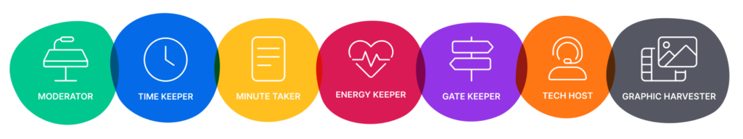
Conclusion and recommendations
Recommendations
Organizational cultural considerations
For projects like SNHU Travel, where requirements are dynamic and client involvement is high, Agile is the recommended approach.
Agile offers the flexibility to adapt to changing requirements and ensures that the final product aligns closely with customer needs.
In contract, for projects with fixed requirements and a clear understanding of the end product, Waterfall may be more appropriate.
The choice of methodology should also consider the organizational culture and readiness for change.
Agile requires a culture that embraces collaboration, continuous improvement, and adaptability.
Waterfall might be more suitable for traditional organizations with well-established processes and a preference for a structured approach.

Slide 8
References
Agile Alliance. (n.d.). Agile 101. Agile Alliance. https://www.agilealliance.org/agile101/
Beck, K., Beedle, M., van Bennekum, A., Cockburn, A., Cunningham, W., Fowler, M., …& Kern, J.(2001). Manifesto for Agile Software Development. Agile Manifesto. https://agilemanifesto.org/
Mountain Goat Software. (n.d.). What is Scrum?. Mountain Goat Software. https://www.mountaingoatsoftware.com/agile/scrum
Project Management Institute. (n.d.). Waterfall vs Agile: Which is the Right Development Methodology for Your Project?. Project Management Institute. https://www.pmi.org/learning/library/waterfall-agile-project-development-methodology-6269
Rouse, M. (2020). Waterfall Model. TechTarget. https://www.techtarget.com/searchsoftwarequality/definition/waterfall-model

